Slide 1



Inbox to Insight: Automating Variance Reports the Smarter Way
Presented By : Sachin Savkare

Slide 2
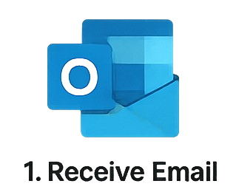
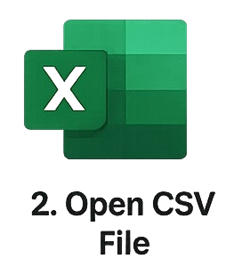


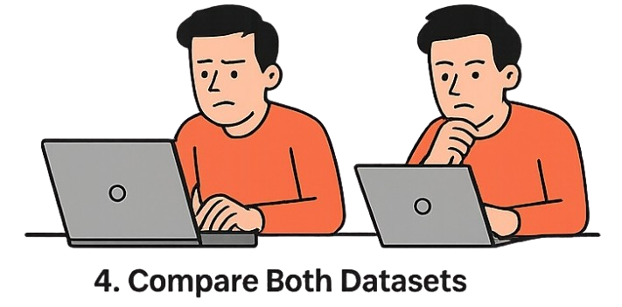


Manual Process
Receive Mail
Open CSV File
Access Old System Data
Compare Both Datasets
Identify Variance
Create Report
Share Report

Slide 3
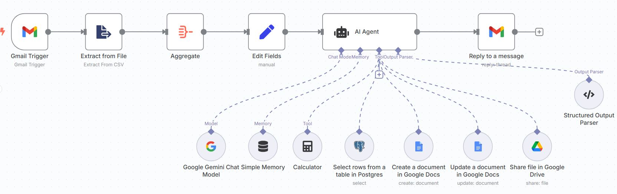
Automate Process
Trigger Email Listener
Extract CSV Data
Fetch Old System Data
Prepare Data for AI
AI Agent Performs Comparison
Share Report Link
Create a Variance Report

